Slide 1
Causal Inference Crash Course: Arguable Validation for Cross-Sectional Models
Julian Hsu

Slide 2
Causal Inference Series
Foundations
Defining Some Causal Models
Arguable Validation
Inference, Asymptotic Theory, and Bootstrapping
Best Practices: Outliers, Class Imbalance, and Feature Selection
Heterogeneous Treatment Effect Models and Inference
[WiP] Models for Panel Data
[WiP] Regression Discontinuity Models

Slide 3
Overview
Since panel models are relatively more straight-forward to test such as testing pre-treatment time parallel trends, this presentation focuses on arguable validation for cross-sectional models.
We will also focus on standard propensity-based models, excluding approaches such as instrumental variable and regression discontinuity.
We will cover some strategies:
Placebo tests
Coefficient stability following Oster (2019)
Feature balancing

Slide 4
What are we arguably validating?
We are interested in estimating some treatment effect.
Ie, the impact of a selection change in a store’s OPS.
Recall the challenge is that we do not observe counterfactual outcomes – what the treatment observations’ outcome would be if they were instead treated, or vice versa.
We don’t know what the store’s OPS would be if we did not change selection.
We rely on assumptions like exogeneity, under which we can expect our model estimates the true treatment effect
So we are trying to validate the assumptions
Notes:
Exogeneity goes by its other names – unconfoundedness, conditional independence assumption

Slide 5
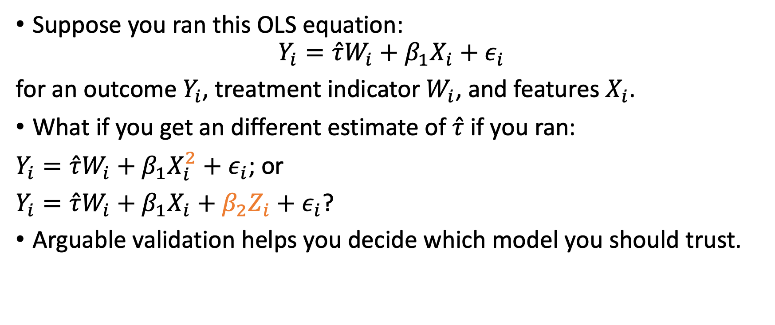
Actions you may take based on arguable validation
Suppose you ran this OLS equation:
$$Y_{i}=\hat{τ}W_{i}+β_{1}X_{i}+ε_{i}$$
for an outcome $Y_{i}$, treatment indicator $W_{i}$, and features $X_{i}$.
What if you get an different estimate of $\hat{τ}$ if you ran:
$Y_{i}=\hat{τ}W_{i}+β_{1}X_{i}^{2}+ε_{i}$; or
$Y_{i}=\hat{τ}W_{i}+β_{1}X_{i}+β_{2}Z_{i}+ε_{i}$?
Arguable validation helps you decide which model you should trust.

Slide 6
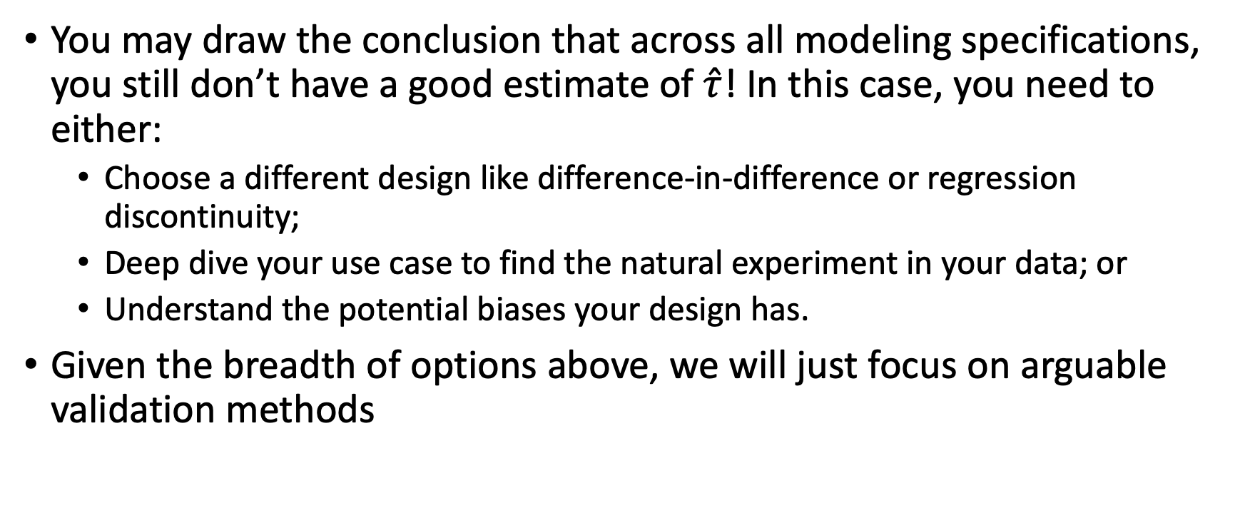
Arguable validation of design
You may draw the conclusion that across all modeling specifications, you still don’t have a good estimate of $\hat{τ}$! In this case, you need to either:
Choose a different design like difference-in-difference or regression discontinuity;
Deep dive your use case to find the natural experiment in your data; or
Understand the potential biases your design has.
Given the breadth of options above, we will just focus on arguable validation methods
Notes:
I will be showing examples using OLS, but the same points can be made about any cross-sectional model like Double/Debiased Machine Learning, Inverse Propensity Weighting, etc.

Slide 7
High Level
Depending on your use case, you may use different ways to arguably validate your causal model
Coefficient stability*
Feature Balancing
Placebo Test
Experiment
Feasibility
Reliability
Notes:
Coefficient stability gets a * to signify that when all else fails, you can use this to get some bounds on your bias

Slide 8
Conducting an experiment
The hard work is at the setup,
But you may not get you what you want

Slide 9
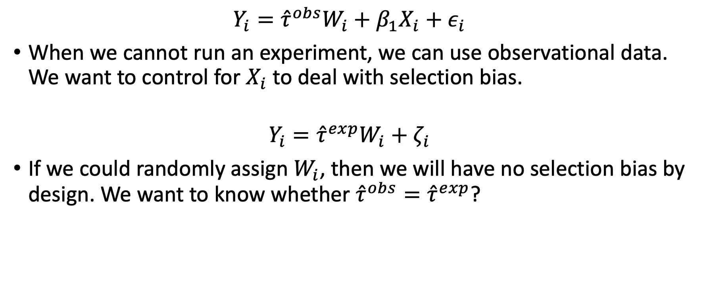
Big idea: create the randomization you wish you had
$$Y_{i}={\hat{τ}}^{obs}W_{i}+β_{1}X_{i}+ε_{i}$$
When we cannot run an experiment, we can use observational data. We want to control for $X_{i}$ to deal with selection bias.
$$Y_{i}={\hat{τ}}^{exp}W_{i}+ζ_{i}$$
If we could randomly assign $W_{i}$, then we will have no selection bias by design. We want to know whether ${\hat{τ}}^{obs}={\hat{τ}}^{exp}$?

Slide 10

Experimentation for validation
Conducting an experiment randomly assigning $W_{i}$ could validate our estimate of $\hat{τ}$.
Observational and experimental analysis can be substitutes or complements:
Substitutes | Complements
1. Do the experiment instead of observational analysis. | Use observational analysis to know where or how to conduct the experiment. Experiment is designed to validate some of the observational results.

Slide 11
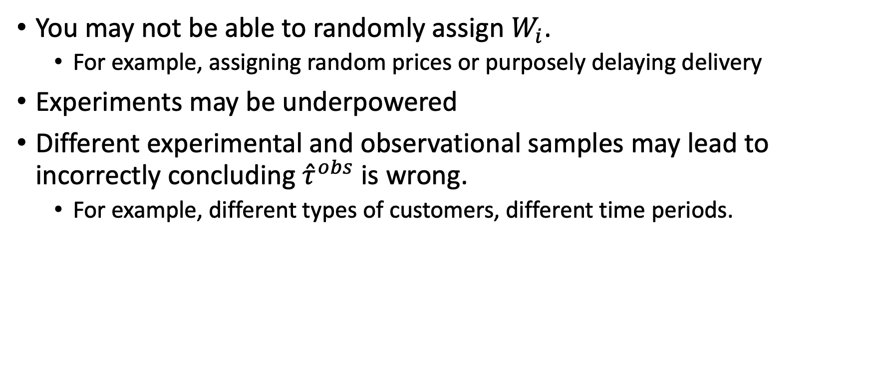
Drawbacks
You may not be able to randomly assign $W_{i}$.
For example, assigning random prices or purposely delaying delivery
Experiments may be underpowered
Different experimental and observational samples may lead to incorrectly concluding ${\hat{τ}}^{obs}$ is wrong.
For example, different types of customers, different time periods.

Slide 12
Placebo test
Easy to do, except when it isn’t.
Not a lot of wiggle room for pivoting.

Slide 13
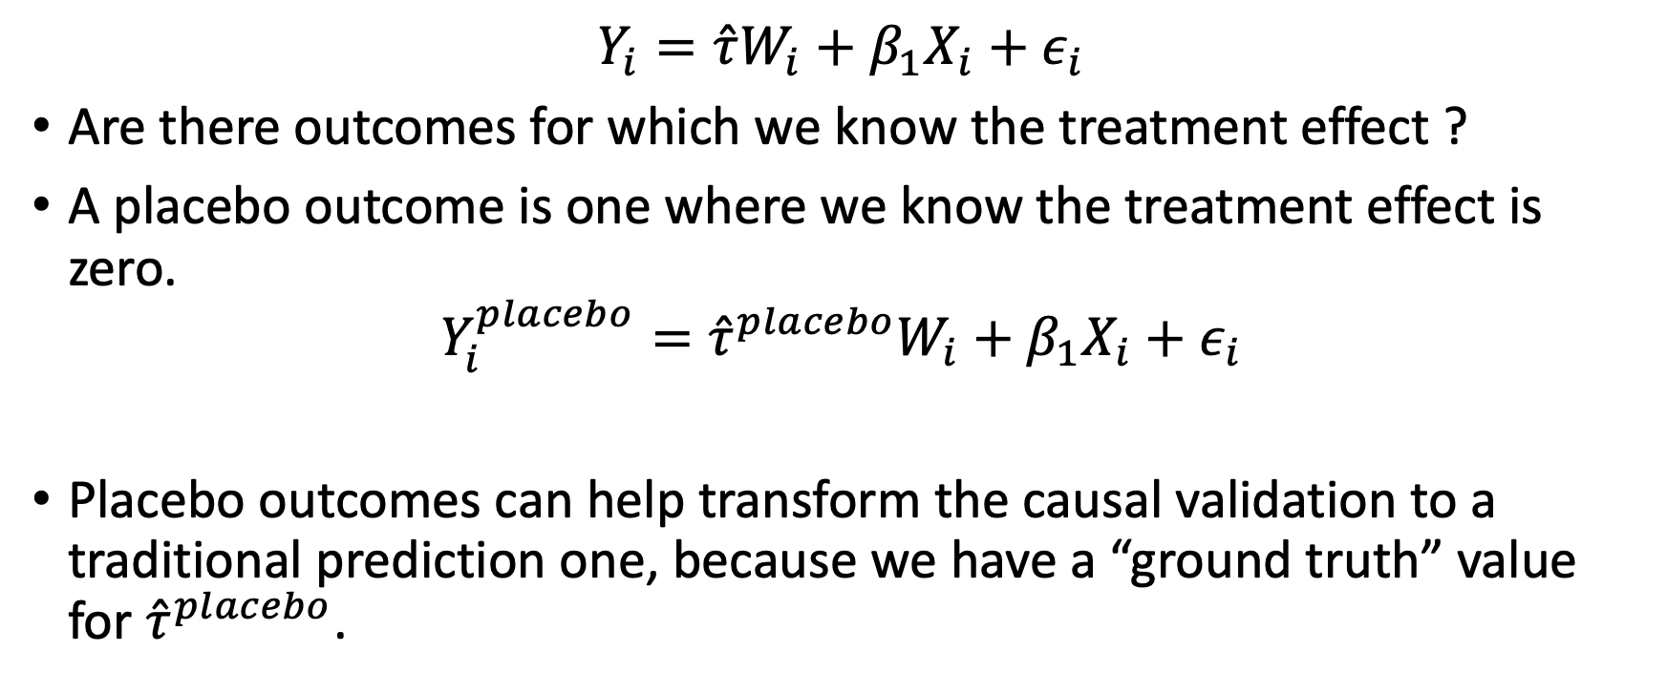
The big idea
$$Y_{i}=\hat{τ}W_{i}+β_{1}X_{i}+ε_{i}$$
Are there outcomes for which we know the treatment effect ?
A placebo outcome is one where we know the treatment effect is zero.
$$Y_{i}^{placebo}={\hat{τ}}^{placebo}W_{i}+β_{1}X_{i}+ε_{i}$$
Placebo outcomes can help transform the causal validation to a traditional prediction one, because we have a “ground truth” value for ${\hat{τ}}^{placebo}$.

Slide 14
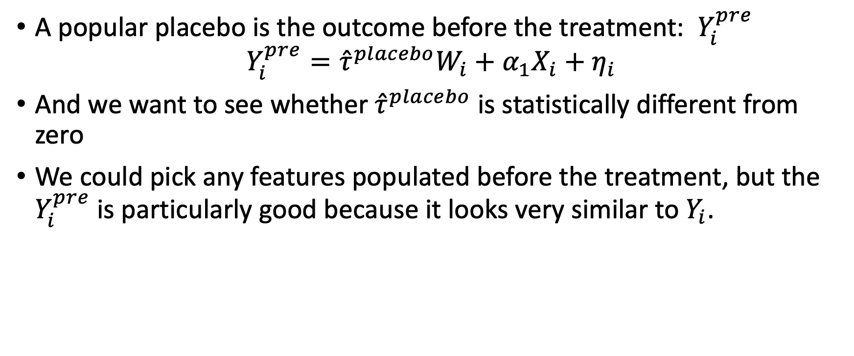
Make a Covariate an Outcome
A popular placebo is the outcome before the treatment: $Y_{i}^{pre}$
$$Y_{i}^{pre}={\hat{τ}}^{placebo}W_{i}+α_{1}X_{i}+η_{i}$$
And we want to see whether ${\hat{τ}}^{placebo}$ is statistically different from zero
We could pick any features populated before the treatment, but the $Y_{i}^{pre}$ is particularly good because it looks very similar to $Y_{i}$.

Slide 15
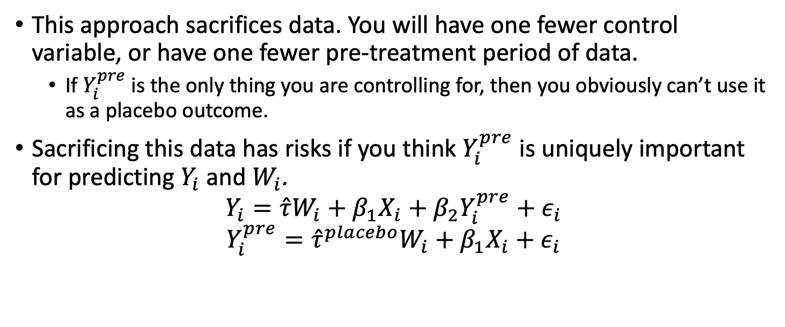
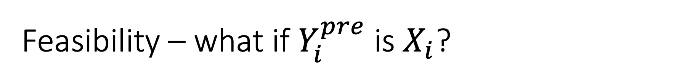
Feasibility – what if $Y_{i}^{pre}$ is $X_{i}$?
This approach sacrifices data. You will have one fewer control variable, or have one fewer pre-treatment period of data.
If $Y_{i}^{pre}$ is the only thing you are controlling for, then you obviously can’t use it as a placebo outcome.
Sacrificing this data has risks if you think $Y_{i}^{pre}$ is uniquely important for predicting $Y_{i}$ and $W_{i}$.
$$Y_{i}=\hat{τ}W_{i}+β_{1}X_{i}+β_{2}Y_{i}^{pre}{+ ε}_{i}$$
$$Y_{i}^{pre}={\hat{τ}}^{placebo}W_{i}+β_{1}X_{i}{+ ε}_{i}$$

Slide 16
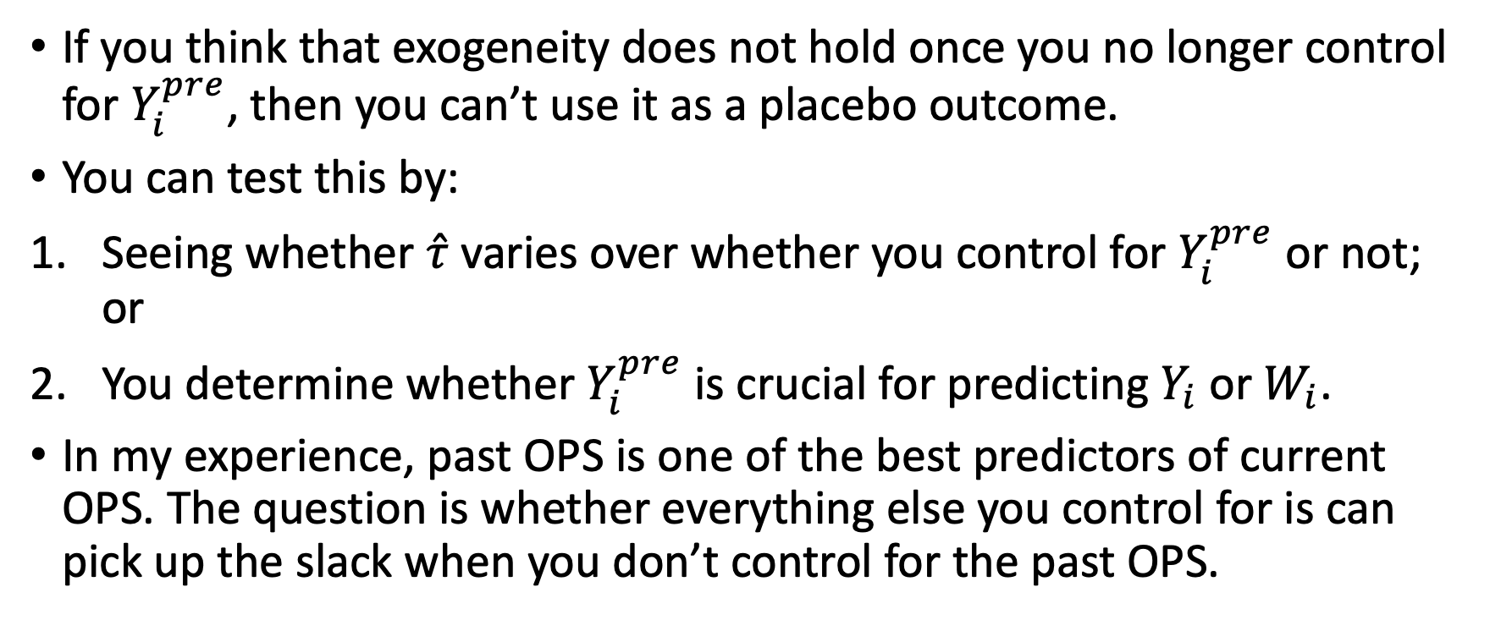
Drawbacks
If you think that exogeneity does not hold once you no longer control for $Y_{i}^{pre}$, then you can’t use it as a placebo outcome.
You can test this by:
Seeing whether $\hat{τ}$ varies over whether you control for $Y_{i}^{pre}$ or not; or
You determine whether $Y_{i}^{pre}$ is crucial for predicting $Y_{i}$ or $W_{i}$.
In my experience, past OPS is one of the best predictors of current OPS. The question is whether everything else you control for is can pick up the slack when you don’t control for the past OPS.
Notes:
Note for models like DML or IPW, you could include the placebo outcome as a control and outcome, but you’ll get spurious answers because you have the same feature as an input and output.

Slide 17
Coefficient stability
Easy to do but requires some judgement.
Even if it fails, you have something to work with.

Slide 18
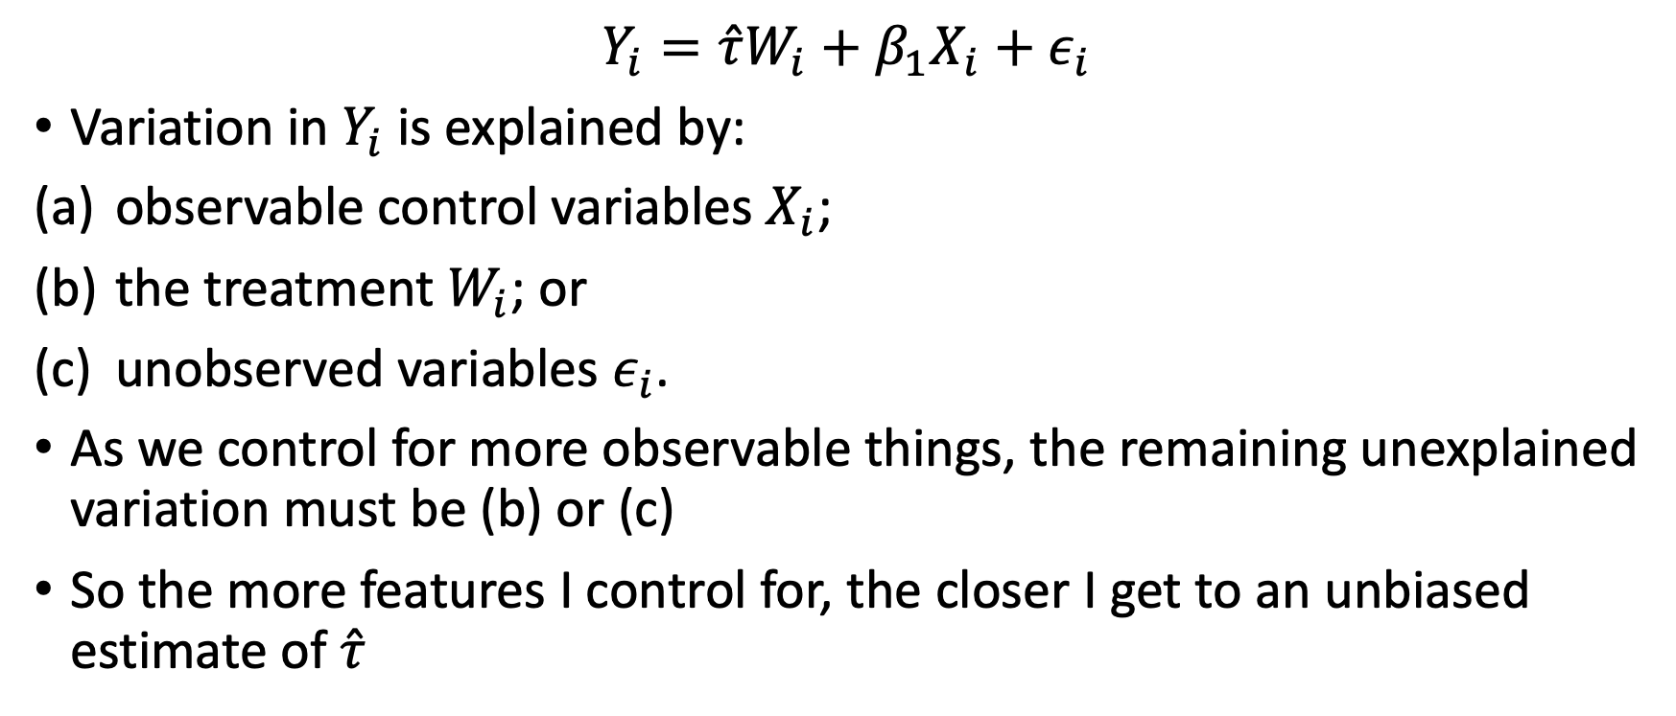
Setup
$$Y_{i}=\hat{τ}W_{i}+β_{1}X_{i}+ε_{i}$$
Variation in $Y_{i}$ is explained by:
observable control variables $X_{i}$;
the treatment $W_{i}$; or
unobserved variables $ε_{i}$.
As we control for more observable things, the remaining unexplained variation must be (b) or (c)
So the more features I control for, the closer I get to an unbiased estimate of $\hat{τ}$
Notes:
I’m going to follow Oster (2019):
“Unobservable Selection and Coefficient Stability: Theory and Evidence.” (2019). Journal of Business & Economic Statistics, 37(2). https://www.tandfonline.com/doi/abs/10.1080/07350015.2016.1227711?journalCode=ubes20
A similar idea is Imbens (2003), but I prefer Oster (2019) because it’s a little less restrictive to technical implication.
“Sensitivity to Exogeneity Assumptions in Program Evaluation.” (2003). American Economic Review, 93(2). https://www.aeaweb.org/articles?id=10.1257/000282803321946921

Slide 19
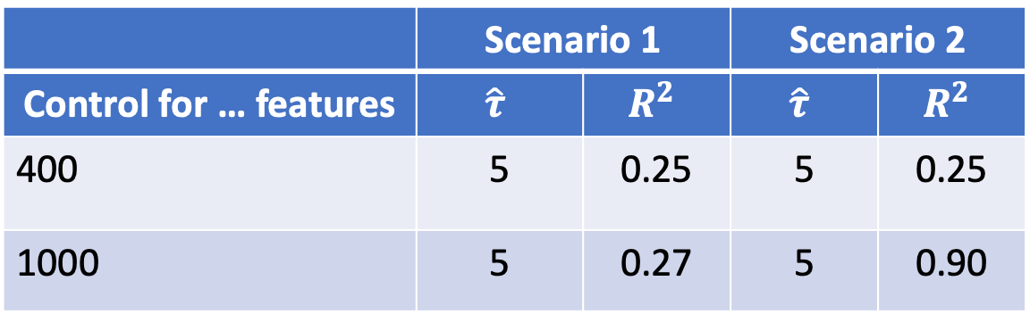
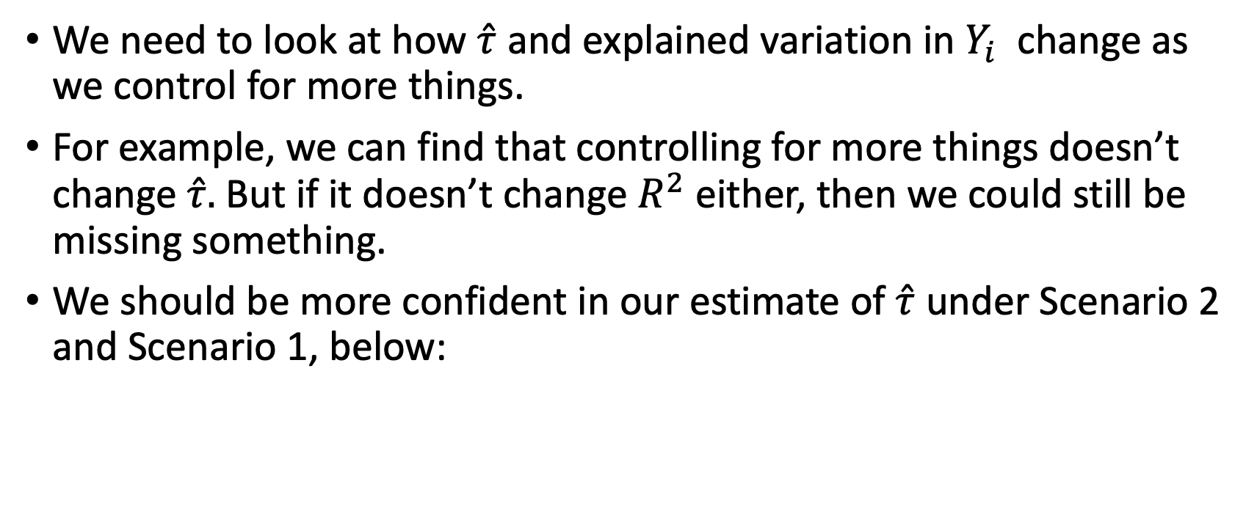
The big idea
We need to look at how $\hat{τ}$ and explained variation in $Y_{i}$ change as we control for more things.
For example, we can find that controlling for more things doesn’t change $\hat{τ}.$ But if it doesn’t change $R^{2}$ either, then we could still be missing something.
We should be more confident in our estimate of $\hat{τ}$ under Scenario 2 and Scenario 1, below:
 | Scenario 1 |  | Scenario 2
Control for … features | $$\hat{τ}$$ | $$R^{2}$$ | $$\hat{τ}$$ | $$R^{2}$$
400 | 5 | 0.25 | 5 | 0.25
1000 | 5 | 0.27 | 5 | 0.90

Slide 20
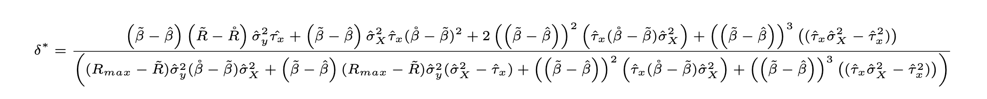
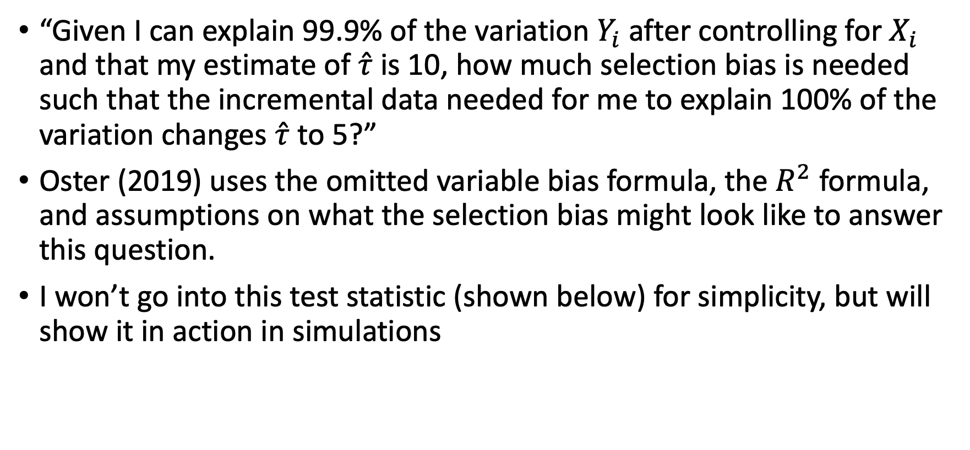
Coefficient stability test and interpretation
“Given I can explain 99.9% of the variation $Y_{i}$ after controlling for $X_{i}$ and that my estimate of $\hat{τ}$ is 10, how much selection bias is needed such that the incremental data needed for me to explain 100% of the variation changes $\hat{τ}$ to 5?”
Oster (2019) uses the omitted variable bias formula, the $R^{2}$ formula, and assumptions on what the selection bias might look like to answer this question.
I won’t go into this test statistic (shown below) for simplicity, but will show it in action in simulations

Slide 21
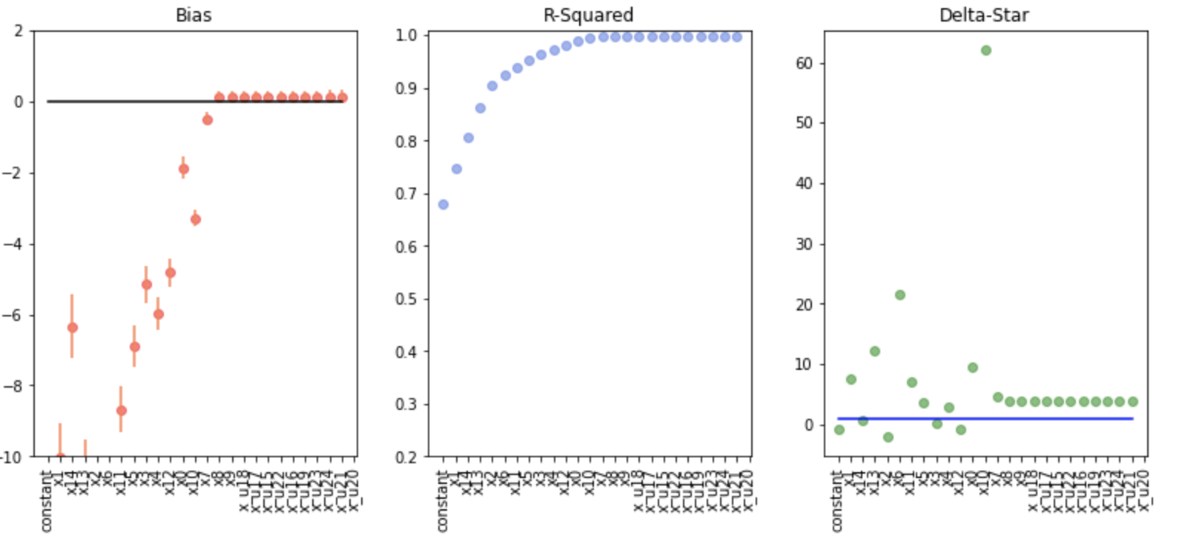
Simulation results
Irrelevant features
Irrelevant features
Irrelevant features
Notebook link
Notes:
$$Y_{i}=\hat{τ}W_{i}+β_{1}X_{i}+ε_{i}$$
$$W_{i}=logit({αX}_{i}+η_{i})$$
Simple endogeneity problem with a linear model.
I will show the bias in $\hat{τ}$, the $R^{2}$, and Oster’s $δ^{∗}$ statistic as I control for more and more features, including irrelevant features.

Slide 22
Drawbacks on Interpretation
Unlike the placebo test which you can either pass or fail based on whether the estimate on the placebo outcome is distinguishable from zero, the interpretation of coefficient stability is less clear.
Coefficient stability embraces the fact that selection bias is unavoidable and tells us how likely it is the selection bias will change our results or conclusion.

Slide 23
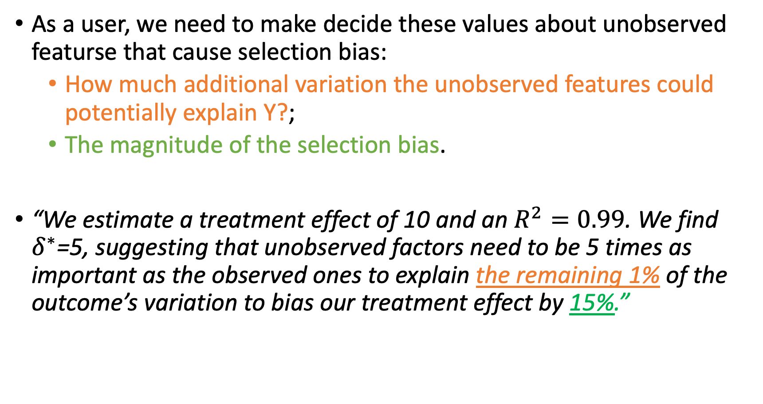
Sample Interpretation
As a user, we need to make decide these values about unobserved featurse that cause selection bias:
How much additional variation the unobserved features could potentially explain Y?;
The magnitude of the selection bias.
“We estimate a treatment effect of 10 and an $R^{2}=0.99$. We find $δ^{∗}$=5, suggesting that unobserved factors need to be 5 times as important as the observed ones to explain the remaining 1% of the outcome’s variation to bias our treatment effect by 15%.”

Slide 24
Feature balancing (aka covariate balancing)
Easiest to do,
But needs it’s own meta-validation.

Slide 25
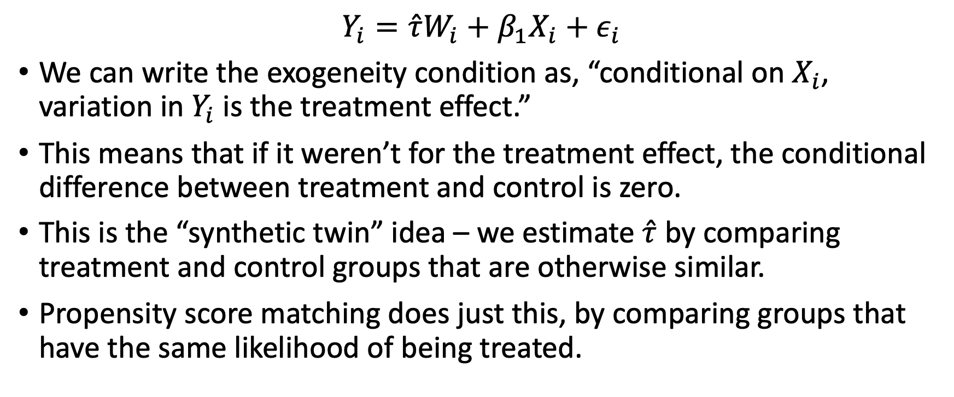
Setup
$$Y_{i}=\hat{τ}W_{i}+β_{1}X_{i}+ε_{i}$$
We can write the exogeneity condition as, “conditional on $X_{i}$, variation in $Y_{i}$ is the treatment effect.”
This means that if it weren’t for the treatment effect, the conditional difference between treatment and control is zero.
This is the “synthetic twin” idea – we estimate $\hat{τ}$ by comparing treatment and control groups that are otherwise similar.
Propensity score matching does just this, by comparing groups that have the same likelihood of being treated.
Notes:
Technically, the exogeneity condition is that conditional on X_i, there are no differences in potential outcomes. This can be extended to the observed outcomes to say the statement above.

Slide 26
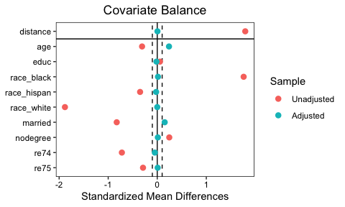
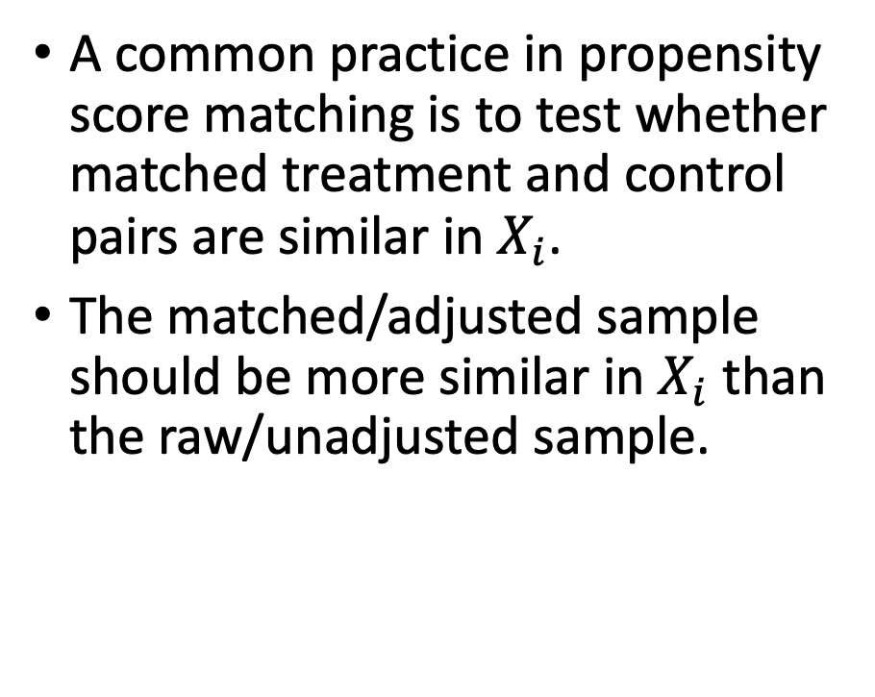
The primitive to the big idea
A common practice in propensity score matching is to test whether matched treatment and control pairs are similar in $X_{i}$.
The matched/adjusted sample should be more similar in $X_{i}$ than the raw/unadjusted sample.
From https://cran.r-project.org/web/packages/cobalt/vignettes/cobalt.html

Slide 27
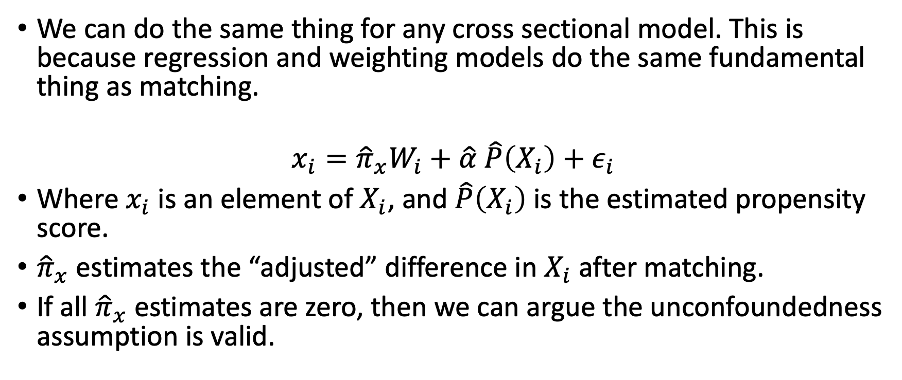
The big idea
We can do the same thing for any cross sectional model. This is because regression and weighting models do the same fundamental thing as matching.
$$x_{i}={\hat{π}}_{x}W_{i}+\hat{α} \hat{P}\left(X_{i}\right)+ε_{i}$$
Where $x_{i}$ is an element of $X_{i}$, and $\hat{P}\left(X_{i}\right)$ is the estimated propensity score.
${\hat{π}}_{x}$ estimates the “adjusted” difference in $X_{i}$ after matching.
If all ${\hat{π}}_{x}$ estimates are zero, then we can argue the unconfoundedness assumption is valid.

Slide 28
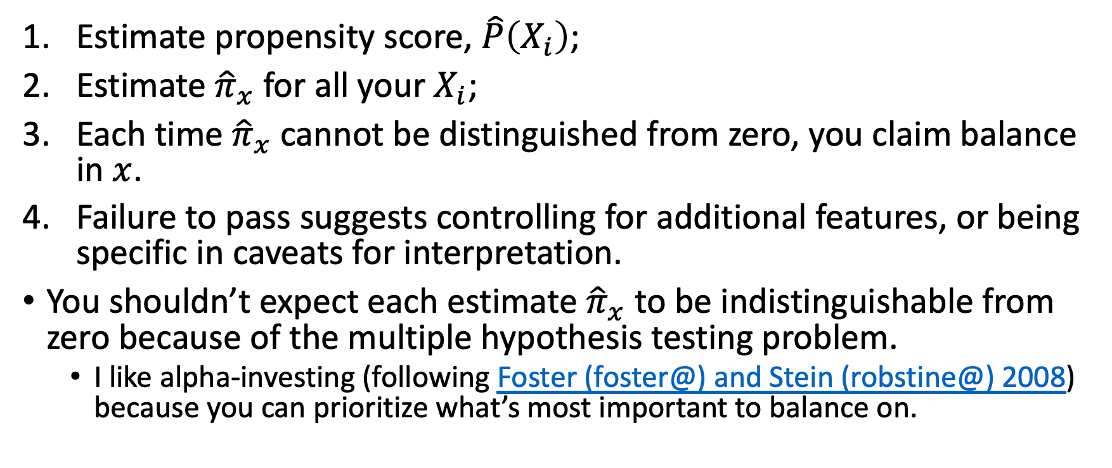
Implementation
Estimate propensity score, $\hat{P}\left(X_{i}\right)$;
Estimate ${\hat{π}}_{x}$ for all your $X_{i}$;
Each time ${\hat{π}}_{x}$ cannot be distinguished from zero, you claim balance in $x$.
Failure to pass suggests controlling for additional features, or being specific in caveats for interpretation.
You shouldn’t expect each estimate ${\hat{π}}_{x}$ to be indistinguishable from zero because of the multiple hypothesis testing problem.
I like alpha-investing (following Foster (foster@) and Stein (robstine@) 2008) because you can prioritize what’s most important to balance on.

Slide 29
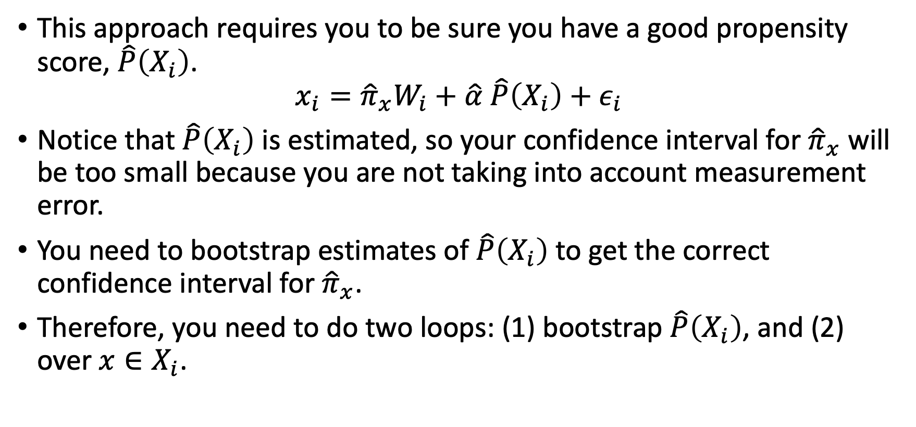
Drawbacks
This approach requires you to be sure you have a good propensity score, $\hat{P}\left(X_{i}\right)$.
$$x_{i}={\hat{π}}_{x}W_{i}+\hat{α} \hat{P}\left(X_{i}\right)+ε_{i}$$
Notice that $\hat{P}\left(X_{i}\right)$ is estimated, so your confidence interval for ${\hat{π}}_{x}$ will be too small because you are not taking into account measurement error.
You need to bootstrap estimates of $\hat{P}\left(X_{i}\right)$ to get the correct confidence interval for ${\hat{π}}_{x}$.
Therefore, you need to do two loops: (1) bootstrap $\hat{P}\left(X_{i}\right)$, and (2) over $x∈X_{i}$.

Slide 30
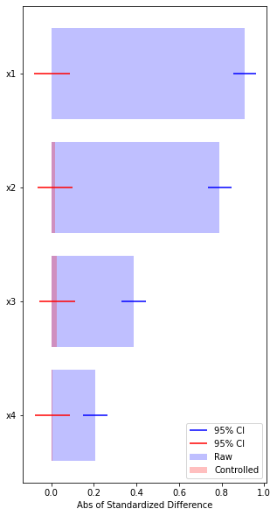
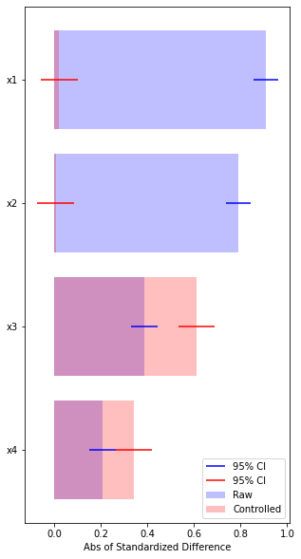
Simulation
When exogeneity condition is true on the left hand side, the controlled differences are smaller.
When it is not true, feature balancing calls out which features we are imbalanced in
Notebook link

Slide 31
Conclusion
Four types of arguable validation for cross-sectional causal models
They all require interpretation of results and help you decide whether your assumption is correct
Coefficient stability*
Feature Balancing
Placebo Test
Experiment
Feasibility
Reliability
Notes:
Coefficient stability gets a * to signify that when all else fails, you can use this to get some bounds on your bias

Slide 32
Causal Inference Series
Foundations
Defining Some Causal Models
Arguable Validation
Inference, Asymptotic Theory, and Bootstrapping
Best Practices: Outliers, Class Imbalance, and Feature Selection
Heterogeneous Treatment Effect Models and Inference
[WiP] Models for Panel Data
[WiP] Regression Discontinuity Models

Slide 33
Literature Review of Related Papers
Placebo Tests
Imbens, Wooldridge. (2009). “Recent Developments in the Econometrics of Program Evaluation.”Iink
Imbens. (2003). “Matching Methods in Practice: Three Examples.” link
Coefficient Stability
Oster. (2019). “Unobservable Selection and Coefficient Stability: Theory and Evidence.” link;
Imbens. (2003). “Sensitivity to Exogeneity Assumptions in Program Evaluation.” link
Feature Balancing
Imai, Ratkovic. (2014). “Covariate balancing propensity score.” link
Sant’Anna, Song, Xu. (2018). “Covariate Distribution Balance via Propensity Scores.” link
Athey, Imbens, Wager. (2016). “Approximate Residual Balancing: De-Biased Inference of Average Treatment Effects in High Dimensions.” link
Ben-Miachel, Feller, Hirschberg, Zubizaretta. (2021).” The Balancing Act in Causal Inference.” link

Slide 34
Appendix Slides

Slide 35
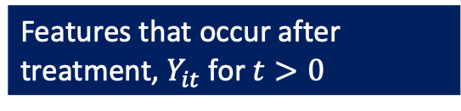
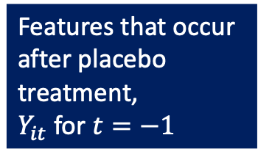
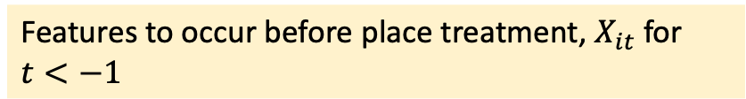

Placebo Type 2: Shift your Entire Dataset Back
Treatment happens at $t=0$
Features that occur after treatment, $Y_{it}$ for $t>0$
Features to occur before treatment, $X_{it}$for $t<0$
Features to occur before place treatment, $X_{it}$for $t<−1$
Features that occur
after placebo
treatment,
$Y_{it}$ for $t=−1$
You always use these controls and these outcomes. In this placebo approach, you pretend the treatment happened before it actually did.

Slide 36
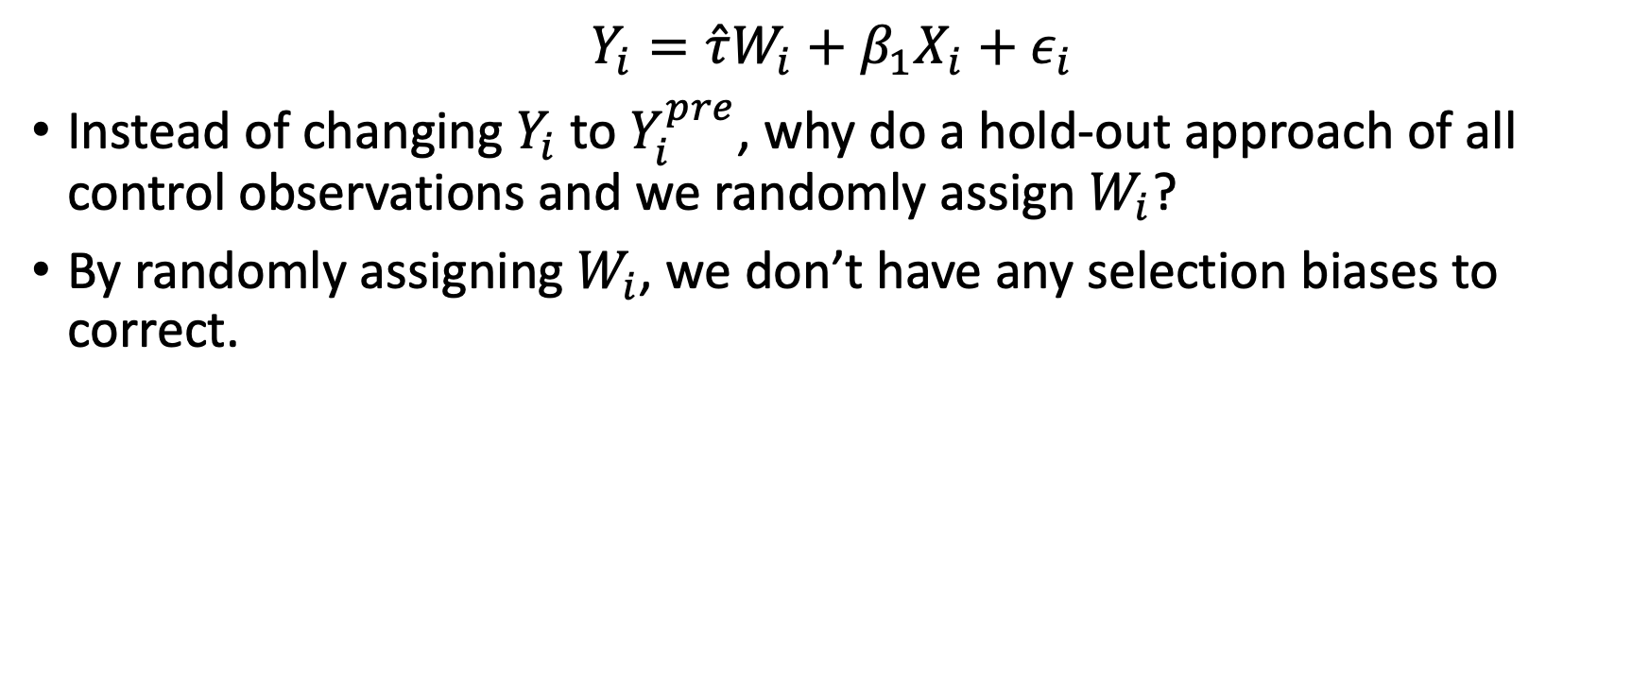
Placebo tests are not A/A tests
$$Y_{i}=\hat{τ}W_{i}+β_{1}X_{i}+ε_{i}$$
Instead of changing $Y_{i}$ to $Y_{i}^{pre}$, why do a hold-out approach of all control observations and we randomly assign $W_{i}$?
By randomly assigning $W_{i}$, we don’t have any selection biases to correct.

Slide 37
Optimize for feature balance
The feature balancing described before has separate estimation steps for estimating the propensity score and the balancing test.
Why not incorporate feature balancing as an objective to estimating the propensity score?
Explored in a few papers:
Sant’Anna, Song, Xu. https://arxiv.org/abs/1810.01370
Athey, Imbens, Wager. https://arxiv.org/pdf/1604.07125

